Slide 1
GSERM: Text Mining & NLP Intros
Ted Kwartler

Slide 2


Slide 3











https://www.linkedin.com/in/edwardkwartler/
Side Hustles

Slide 4
Introductions…
Name
Location
Background
Why are you taking this course?
Are you working on VM, local or cloud?

Slide 5
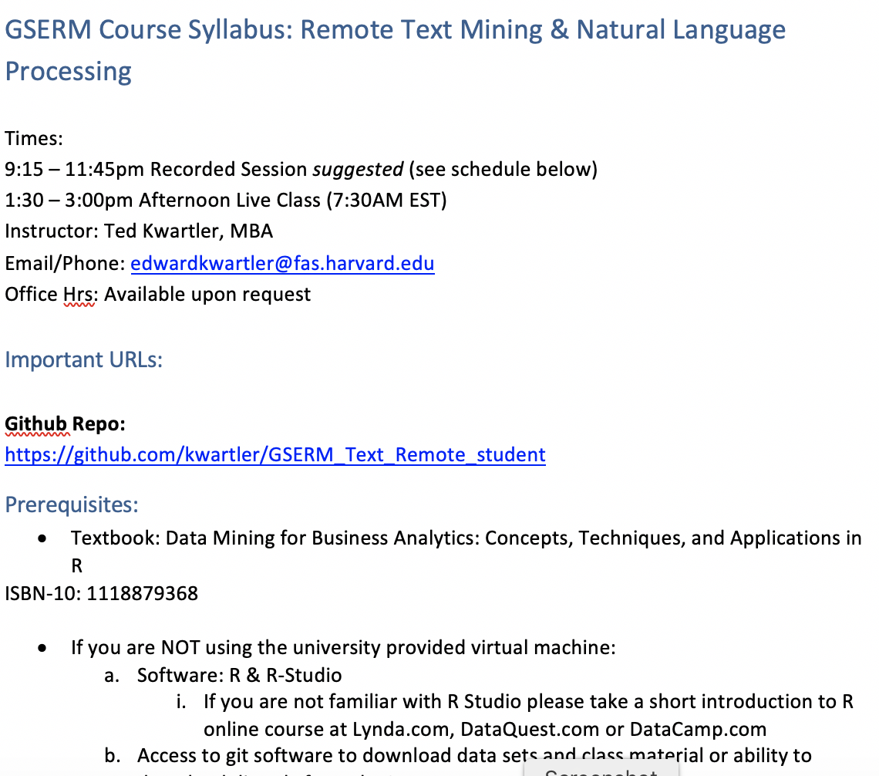
Syllabus Review

Slide 6
Community Learning Expectations
I expect:
Kindness > Cleverness
Active learning & participation
To make adjustments along the way so learning will be engaging & fun
Academic rigor
My goal for your learning experience is that the topics are:
Interesting
Applicable as a professional, researcher or future business person
Perspective building as a consumer affected by these methods
I do not expect:
Expert programmers or production quality coding skills – not really a programming course
Significant math skills – not a heavy math course

Slide 7

A safe/supportive learning environment
In this class, we use a lot of tweets…which have never been read.
“Keyboard Courage” is rampant which may entail some less than ideal topics.
Twitter is a realistic Natural Language Channel
It is a great place to get topics, and messy challenging data.
As a safe learning environment, no offense is intended, merely exposure to a real data set. If offended, please reach out and I will get you additional data sets.
#%@*!!!

Slide 8
My style
You learn from being challenged
This is a intensive 1 week course requiring programing.
Don’t be intimidated if its your first time with R. My job is your learning outcomes. I am here to help.
It can be uncomfortable learning something new.
Discomfort means you are applying/challenging yourself. It’s ok and expected.
The professor doesn’t give everyone the top scores & no extra credit.
You earn the actual grade but I am fair and reasonable
“Homework/reading is taking hours & I want to go to social activities.”
You are earning credit in an intensive manner. Expect intensity and rigor at a prestigious institution.

Slide 9

Some motivation
If you are struggling, ask Prof help, evening labs, lunchtime office hours, email or even smoke signals, whatever it takes to succeed.
Focus on your learning outcomes
Don’t focus on your grade
You own the level of effort & engagement in your learning
I am focused on your learning outcomes
I don’t care if you need a specific grade to graduate
I take my role seriously mirroring your effort & engagement to support learning

Slide 10
Video- Installation Q/A
Who had trouble installing R?
Who had trouble installing Rstudio?
Who had trouble installing Git?

Slide 11
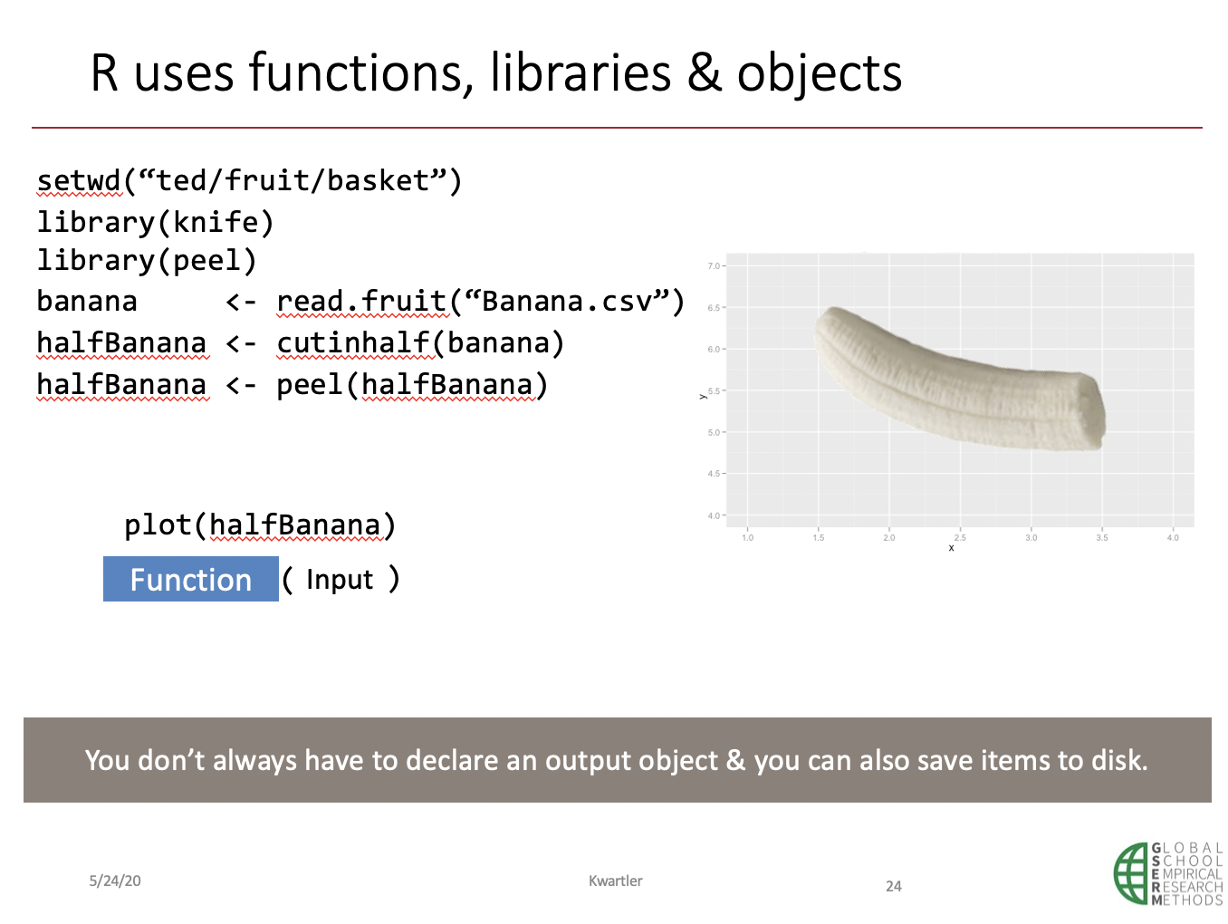
Video 2 Q/A
Does the input, function, output process make sense?
Does the banana analogy and workflow make sense?
What is “<-” called?
Why do we need libraries in R?

Slide 12
In video 3, we took R for a test drive.

Slide 13
Let’s get back into R, to review.
Please open live_A_more_basics.R

Slide 14
GSERM: Text Mining & NLP TM Basics

Slide 15
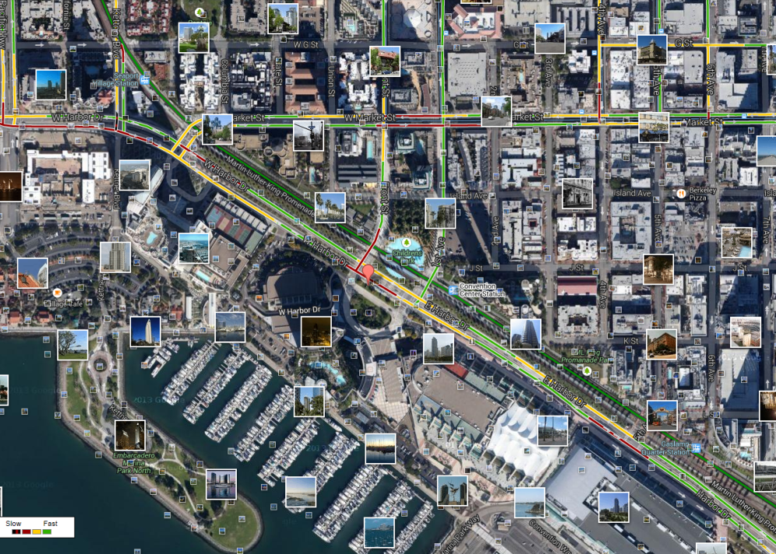
What is Text Mining?
Before Text Mining
Extract new insights from text
Let’s you drink from a fire hose of information
Language is hard; many unsolved problems
Unstructured
Expression is individualistic
Multi-language/cultural implications

Slide 16
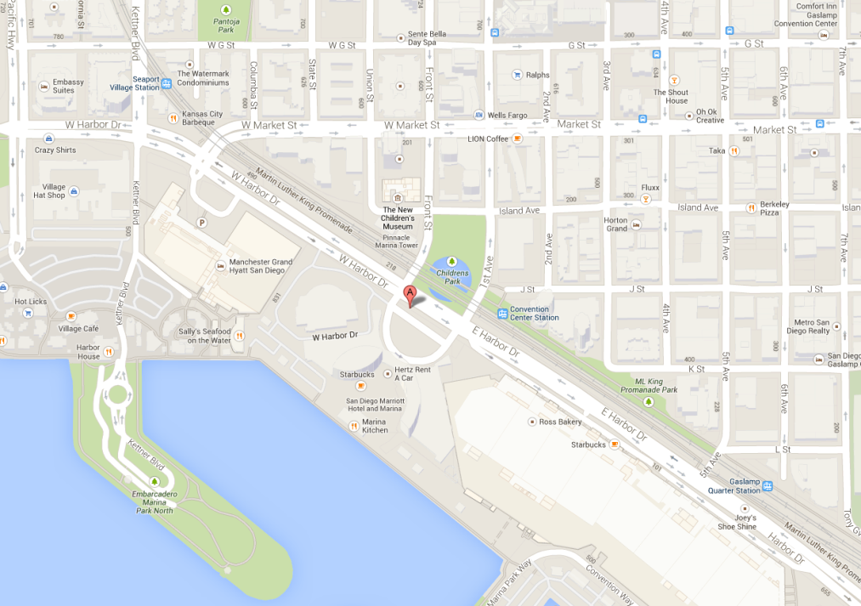
What is Text Mining?
After Text Mining
Extract new insights from text
Let’s you drink from a fire hose of information
Language is hard; many unsolved problems
Unstructured
Expression is individualistic
Multi-language/cultural implications

Slide 17
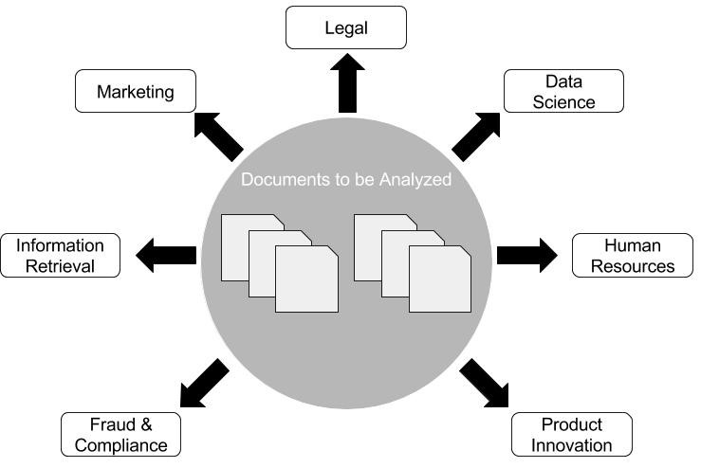
Where can NLP & Text Mining be used? Anywhere there are documents!

Slide 18
Where do you observe NLP? What about your research ideas?

Slide 19
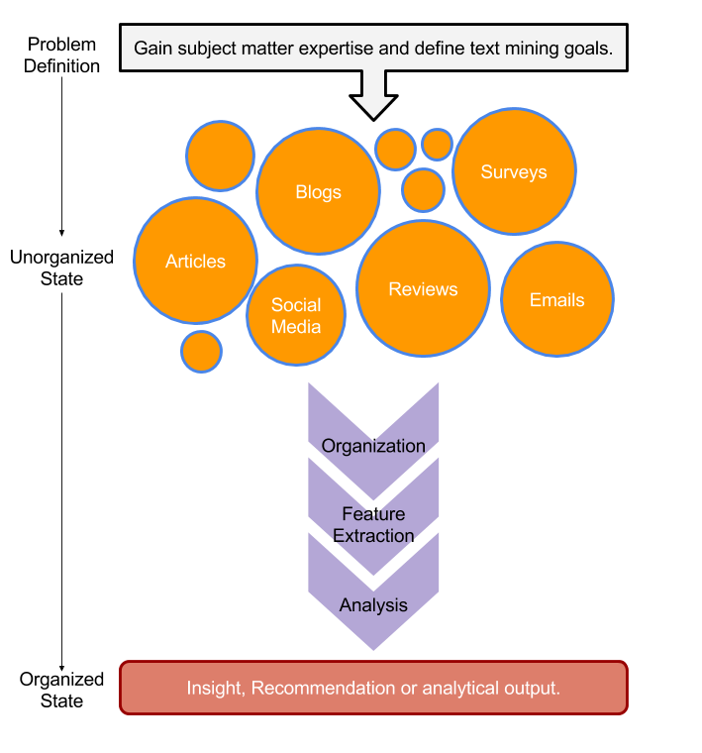
TM Project Workflow
Unorganized State
Natural Language Processing & Analysis
Organized State

Slide 20
Text Mining Workflow
Problem Definition
Identify Text Sources
Text Organization
Feature Extraction
Analytics
Reach Insight or Recommendation

Slide 21
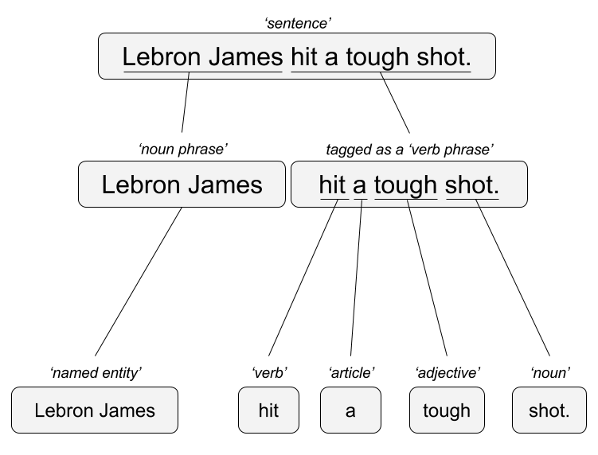

Two Popular Approaches
“Lebron James hit a tough shot.”
Syntactic Parsing
Bag of Words
Lebron
a
James
hit
tough
shot
*There are other approaches usually based on DNN, that I refer to “abstractive”

Slide 22

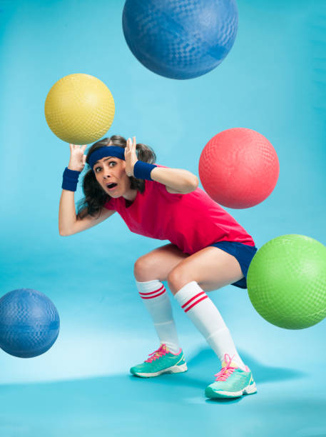
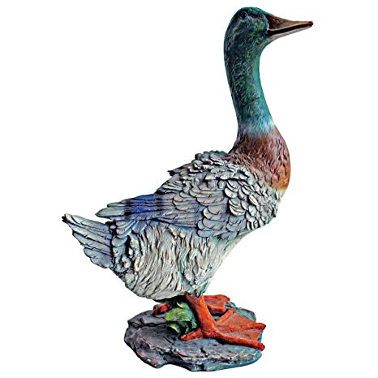
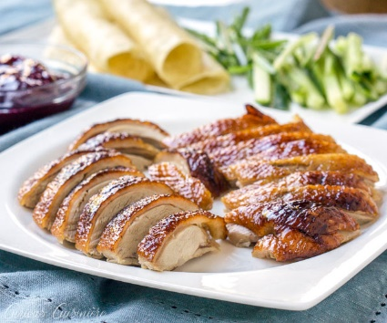
TM Challenges - Disambiguation
I made her duck.
I cooked waterfowl for her to eat.
I cooked waterfowl belonging to her.
I created the (clay?) duck and gave it to her.
Duck!!

Slide 23
TM Challenges - Misc
Other Challenges
Examples
Compound words (tokenization) change meaning
Sarcasm
Cultural differences
“Bad” vs “not bad”
“I like it…NOT!”
“It’s wicked good” (in Boston)

Slide 24





Why text mining is an art & science?
Challenges because human expression is diverse, often ambiguous, affected by age, demographics, socio-economics, medium/channel & regional attributes of the author.
Common Sources
Source & context are important, directly impacting data integrity.
Books
Electronic Docs (PDFs)
Blogs
Websites
Social Media
Customer Records
Customer Service Notes
Notes
Emails
Legal Documents
…

Slide 25



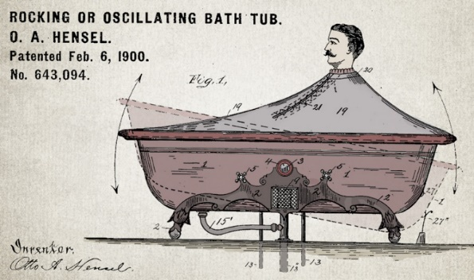


Channel affects language
Legal documents are verbose & technical.
“Be the change you want to see in the world.”
“kappa” indicates sarcasm, irony,
or a joke among online gamers.
Expression is context specific making analysis challenging.

Slide 26
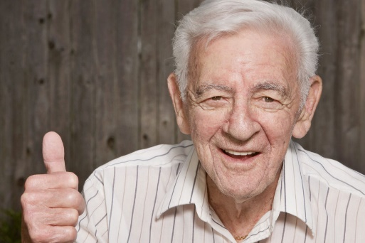


Messenger affects language
Boomers 1946-1964
* Make a difference * Consensus/team * Experiment/try new things * “Imagine if…” * Save time * Features and benefits
Gen X 1965-1980
Best, finest, world-class
“You will benefit by…”
”This is in your best interest.”
Gen Y 1981-2000
Global citizen
Balance
Diversity
Community/connections
Beyond generation, other factors like socio-economic, gender & demographic makeup impact expression.
https://www.anneloehr.com/

Slide 27


Gen Y/Z expression is evolving rapidly due to technology.
“Thank you, next.”
“Woke”
“Cray”
“Gucci”
“Squad goal”
“Bible…”
“Adulting”
“Turnt”
“Hundo P”
“Trill”
“TFW”
Beyond generation, other factors like socio-economic, gender & demographic makeup impact expression.

Slide 28
Gen Y/Z expression is evolving rapidly due to technology.
“Thank you, next.” – moving on with positive connotation
“Woke” - The more woke one is, the more sympathetic & knowledgeable one is about a topic or type of person
“Cray” - crazy
“Gucci” – fine, good
“Squad goal” – friend group behavior
“Bible…” - what follows is TRUTH
“Adulting” – activities associated with growing up
“Turnt” – “turned up” i.e. really excited
“Hundo P” – agree “100%”
“Trill” – True & Real
“TFW” – “That Feeling When” to describe an emotion
Beyond generation, other factors like socio-economic, gender & demographic makeup impact expression.

Slide 29




Audience affects language
And we all context switch based on who we are speaking too.

Slide 30
Warning: Twitter Profanity
Twitter demographics skew young and as a result have profanity that appear in the examples. “Keyboard Courage” is rampant.
It’s the easiest place to get a lot of messy text fast, if it is offensive feel free to talk to me and I will work to get you other texts for use on your own. No offense is intended.
#%@*!!!

Slide 31
Basic String Searching
Basic R Unix Commands
Setup
grepl returns a vector of T/F if the pattern is present at least once
grepl(“pattern”, searchable object, ignore.case=TRUE)
grep returns the position of the pattern in the document
grep(“pattern”, searchable object, ignore.case=TRUE)
“library(stringi)” Functions
stri_count counts the number of patterns in a document
stri_count(searchable object, fixed=“pattern”)

Slide 32

Coffee!! Open ﻿ ﻿live_B__dealing_w_Strings.R
Learning Outcome: Start working with strings and related functions.

Slide 33
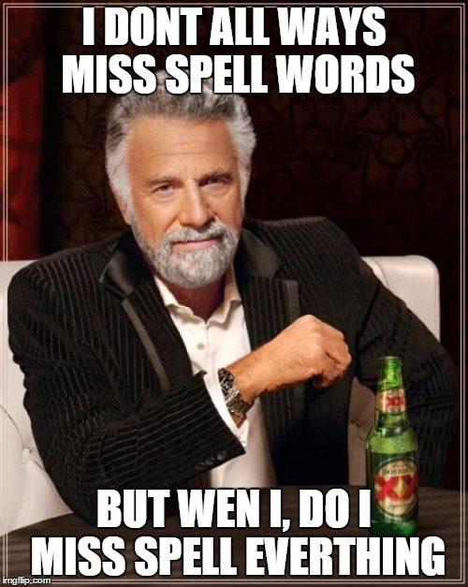
What about misspelling?
Prevalent
Painful to correct
Channel specific

Slide 34
R packages to deal with misspelling
library(qdap)
check_spelling(…)
check_spelling_interactive(…)
Crashes Rstudio.cloud!
Separate the words from a string into individual terms.
Look those words up in a dictionary to find words not recognized/found (considered possibly misspelled).
These misses (possible misspellings) will be what is looked up for suggested replacements and top “n” terms returns. It uses “string distance” the number of characters needed to change the unknown into the known word in the dictionary.

Slide 35
R packages to deal with misspelling
library(hunspell) #https://hunspell.github.io
hunspell_check(…)
hunspell_suggest(…)
hunspell_analyze(…)
Clunky to use!
Check the terms (doesn’t always catch the terms as well as qdap in my exp)
Identify the suggestions
No way to get suggestions easily corrected and inserted!
Same spelling engine used for Chrome/Firefox etc.

Slide 36
R packages to deal with misspelling
Library(spelling)
spell_check_text(…)
We will use in this course but pg 45 of the book has the qdap option
Check the terms
Identify the suggestions
Organize the suggestions into a lexicon
Use a global substitution (gsub) to correct identified misspellings
Still uses the benefit of hunspell but is easier to interact with.

Slide 37

Too much coffee! Open ﻿live_C__spellCheck_examples.R
Learning Outcome: Identify and correct misspelled words in a text vector.

Slide 38
How about some additional strings? Yippee!!
live_D_more_string_manipulation.R

Slide 39
Remember This?

Slide 40

R for Cleaning Steps
Tomorrow I’m going to have a nice glass of Chardonnay and wind down with a good book in the corner of the county :-)
Remove Punctuation
Remove extra white space
Remove Numbers
Make Lower Case
Remove “stop” words
blogs
reviews
articles
tomorrow going nice glass chardonnay wind down good book corner county

Slide 41
Bag of Words “Lebron James hit a tough shot.
Bag of Words
Information is extracted based on frequency or weighting. Steps are taken to aid aggregation.
Example Text Changes:
Capitalization
Coffee = coffee
Punctuation
shot. = shot
Numbers
One = 1 or removed
Stopwords
Remove non-informative terms ie “and” “the”
Lebron
a
James
hit
tough
shot

Slide 42

Library TM Functions
VCorpus creates a corpus held in memory.
VCorpus(source)
Document
Corpus
Corpora
Corpus- A collection of documents that analysis will be based on.
5/27/23
Kwartler CSCI -96
42

Slide 43
Corpora Examples
Hamlet
All Shakespearn Works
Shakespeare, Chaucer,
Alcott & Dickens
Intra-document
Analysis
Intra-subject
Collective Analysis
Inter-subject/author
Comparative Analysis
5/27/23
Kwartler CSCI -96
43

Slide 44
Library TM Functions
VCorpus creates a corpus held in memory.
VCorpus(source)
tm_map applies the transformations for the cleaning
tm_map(corpus, function)
getTransformations() will list all standard tm corpus transformations.
5/27/23
Kwartler CSCI -96
44

Slide 45
Library TM Functions
VCorpus creates a corpus held in memory.
VCorpus(source)
tm_map applies the transformations for the cleaning
tm_map(corpus, function)
Corpus
tm_map(corpus, removePunctuation)
tm_map(corpus, stripWhitespace)
tm_map(corpus, removeNumbers)
tm_map(corpus, content_transformer(tolower))
tm_map(corpus, removeWords)
content_transformer(Function) is needed to modify a corpus for non-tm package functions
5/27/23
Kwartler CSCI -96
45

Slide 46
Library qdap Functions
mgsub(“search pattern”, “replacement pattern”, text object)
replace_abbreviation()
replace_contraction()
replace_number() #1 to one
replace_ordinal() #1st to first
replace_symbol()
tm_map(corpus, content_transformer(replace_contractions))
tm_map(corpus, content_transformer(replace_abbreviation))
5/27/23
Kwartler CSCI -96
46

Slide 47
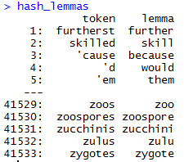
Poor Man’s Lemmatization (more to come later)
library(lexicon)
Qdap’s mgsub function can help you lemmatize words.
Bring in a lemmatization lexicon.
Supply a vector of patterns to search for
Supply a vector of patters to replace or change into.
Specify the vector the lexicon and substitutions should be applied to.
Better w UD PIPE covered on Friday
# Poor Man's Lemmatization
library(lexicon)
library(qdap)
data(hash_lemmas)
text$text <- mgsub(hash_lemmas$token,hash_lemmas$lemma,text$text)
Warning,: Not done in class because it takes a long time.

Slide 48
Custom Functions in this class
“tryTolower” is poached to account for errors when making lowercase.
tryTolower <- function(x){
# return NA when there is an error
y = NA
# tryCatch error
try_error = tryCatch(tolower(x), error = function(e) e)
# if not an error
if (!inherits(try_error, 'error'))
y = tolower(x)
return(y)}
Base: tolower (basic) – fails if not utf-8
Stringr: str_to_lower (wrapper) – fails if not utf-8
Custom: tryTolower (handles errors) – fault tolerant!

Slide 49
Custom Functions in this class
“cleanCorpus” is a convenience wrapper for basic cleaning operations
cleanCorpus<-function(corpus, customStopwords){
corpus <- tm_map(corpus, content_transformer(qdapRegex::rm_url))
corpus <- tm_map(corpus, removePunctuation)
corpus <- tm_map(corpus, stripWhitespace)
corpus <- tm_map(corpus, removeNumbers)
corpus <- tm_map(corpus, content_transformer(tryTolower))
corpus <- tm_map(corpus, removeWords, customStopwords)
return(corpus)
}

Slide 50
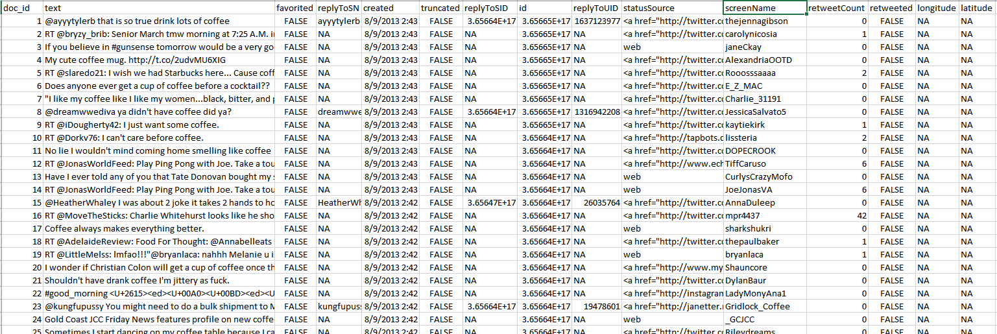
Meta Example
'$doc_id'
'$text'
META: $favorited, $created …
ID is for organization
Text is the information we want to examine
Meta adds context to our observations.

Slide 51
Nuances & Inputs for Setting Up a TM Project
“customStopwords” combines vectors of words to remove from the corpus
#Create custom stop words
customStopwords <- c(stopwords('english'), 'lol', 'smh')
Add channel specific stop words such as “lol” and “smh” for social media

Slide 52
Nuances & Inputs for Setting Up a TM Project
Retaining meta data information
# Data
text<-read.csv('coffee.csv', header=TRUE)
# As of tm version 0.7-3 tabular was deprecated
names(text)[1]<-'doc_id' #first 2 columns must be 'doc_id' & 'text'
txtCorpus <- VCorpus(DataframeSource(text))
txtCorpus <- cleanCorpus(txtCorpus)
The result is a list so brackets matter for accessing text vs meta-data.

Slide 53
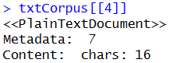
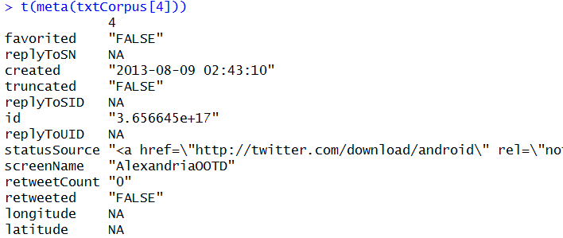
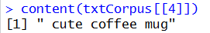
How do you retain meta information?
What is Meta?
What is content?
Meta information is data associated with the data you are analyzing. These can add context and allow you to partition data in insightful ways.
Timestamp (pre 9/11 Vs post 9/11)
Language (American Vs King’s English)
Author (Trump Vs Clinton)
Channel (Twitter Vs Legal Documents)
Content is simply the text (strings) you are analyzing. These data points represent the information of interest you are looking to gain insights from.
Retaining/Extracting Meta
Examining Content
SINGLE BRACKET
DOUBLE BRACKET
During an analysis it may be helpful to examine both meta & content information.

Slide 54
Bag of Words: TERM DOCUMENT MATRIX
The matrices are sparse (many 0’s) so additional steps may be needed to extract information.
Term Document Matrix
 | Tweet1 | Tweet2 | Tweet3 | Tweet4 | … | Tweet_n
Term1 | 0 | 0 | 0 | 0 | 0 | 0
Term2 | 1 | 1 | 0 | 0 | 0 | 0
Term3 | 1 | 0 | 0 | 2 | 0 | 0
… | 0 | 0 | 3 | 0 | 1 | 1
Term_n | 0 | 0 | 0 | 1 | 1 | 0
txtDtm <- TermDocumentMatrix(txtCorpus)
txtDtmM <- as.matrix(txtDtm)

Slide 55
Bag of Words: DOCUMENT TERM MATRIX
The matrices are sparse (many 0’s) so additional steps may be needed to extract information.
Document Term Matrix
 | Term1 | Term2 | Term3 | … | Term_n
Tweet1 | 0 | 1 | 1 | 0 | 0
Tweet2 | 0 | 1 | 0 | 0 | 0
Tweet3 | 0 | 0 | 0 | 3 | 0
… | 0 | 0 | 0 | 1 | 1
Tweet_n | 0 | 0 | 0 | 1 | 0
txtTdm <- DocumentTermMatrix(txtCorpus)
txtTdmM <- as.matrix(txtTdm)

Slide 56
Once cleaned, let’s get word frequencies.
beerFreq<-rowSums(beerTDMm)
beerFreq<-data.frame(word=names(beerFreq),frequency=beerFreq)
Term Document Matrix
Word Frequency Matrix
 | Tweet1 | Tweet2 | Tweet3 | Tweet4 | … | Tweet_n
Term1 | 0 | 0 | 0 | 0 | 0 | 0
Term2 | 1 | 1 | 0 | 0 | 0 | 0
Term3 | 1 | 0 | 0 | 2 | 0 | 0
… | 0 | 0 | 3 | 0 | 1 | 1
Term_n | 0 | 0 | 0 | 1 | 1 | 0
word | freq
Term1 | 0
Term2 | 2
Term3 | 3
… | 5
Term_n | 2

Slide 57
What about a DTM?
beerFreq<-???????(beerDTMm)
beerFreq<-data.frame(word=names(beerFreq),frequency=beerFreq)
Document Term Matrix
Word Frequency Matrix
 | Term1 | Term2 | Term3 | … | Term_n
Tweet1 | 0 | 1 | 1 | 0 | 0
Tweet2 | 0 | 1 | 0 | 0 | 0
Tweet3 | 0 | 0 | 0 | 3 | 0
… | 0 | 0 | 0 | 1 | 1
Tweet_n | 0 | 0 | 0 | 1 | 0
word | freq
Term1 | 0
Term2 | 2
Term3 | 3
… | 5
Term_n | 2
Can anyone think of how you could get a DTM to be a WFM?

Slide 58
Let’s practice! Open ﻿live_E_text_organization.R
Code to Create the DTM/ and change to a matrix
txtDTM <- DocumentTermMatrix(txtCorpus)
txtTDM <- TermDocumentMatrix(txtCorpus)

Slide 59
Lab/Homework
Due TUES Before Class!
﻿Complete: Day1_HW_Student.R
EMAIL YOUR R SCRIPT TO edwardkwartler@fas.Harvard.edu
I will not chase down assignments, don’t be late or forget!
Due before class

